Slide 1
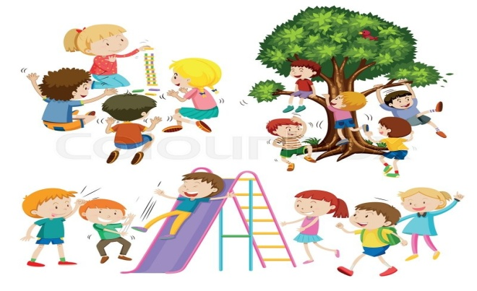
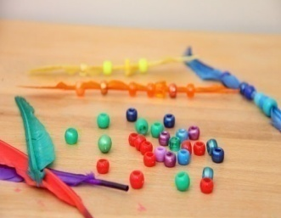
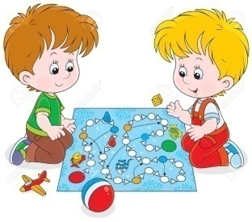
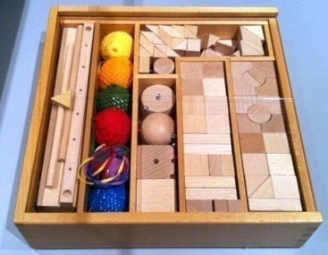
Powers of Play
By Pooja Foria
(academic coach, guide and blogger)

Slide 2
‘All work and no play, makes Jack a dull boy but
don’t you think it's making ours too.’
Recent surveys of frustration, anger, depression, illness, etc have shown that how focusing on just marks and tests are adversely affecting a child’s innocent childhood.
It is true that academics is an important part of our life but just making it a centre of attraction and driving our children towards our goals is leading children to a verge of nervous breakdown , as for the children , their only daily task has become to go to school , do homework, study for the test and so on.
What one has forgotten is to give time and space to the children that can help them break the monotony of their daily routine life and give them a chance to vent out their emotion from an outlet called Play.

Slide 3
Play symbolizes a feeling of freedom wherein the children can express their feelings and emotions associated with their personality.
Play should not be bided by control but it should be a freedom to do something out of box that involves creativity, originality and uniqueness. This can be achieved only if we allow our kids to experience different types of play in different forms.
Play should not be just limited to one’s comfort zone but should be allowed to be explored out of one’s comfort zone .Remember; Play is a form of exploration.
It's a necessity, promoting to growth and development.
Play has the therapeutic value to heal many problems and challenges a child faces in his infancy, and childhood stage .It has the ability to generate a stimulus – responded behavior.
Play can promote multiple intelligences in a child. From good habits to concept of care , share and conflict resolution too can be learnt through play.
Play is the work of Childhood, if presented in a right manner.

Slide 4
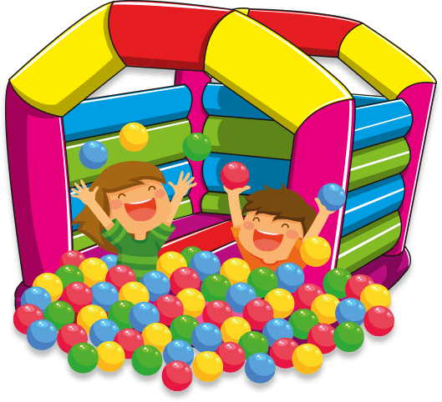
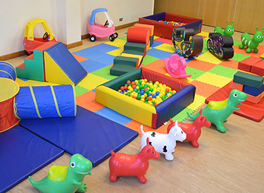
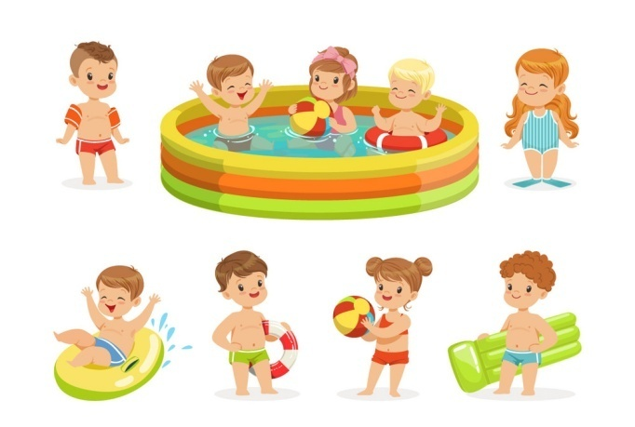
There are different types of play that can cater your child’s developmental needs.
Soft play – It is all about playing with soft toys or any material that can provide ease and comfort as well as calmness. ex: One can encourage making of puppets from cotton balls or using of different materials in sticking or dabbing activities.
Water play – It can stimulate one’s senses, improve blood circulation along with relaxing your nervous system. Learning of different concepts like sink and float, top and bottom can take place too , without making a much due effort.

Slide 5
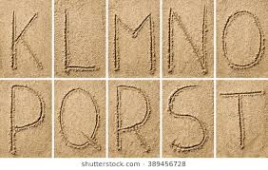
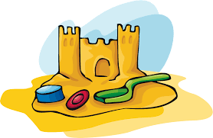
Sand Play- It can prove useful in learning patterns, alphabets, numbers , etc by writing in sand, moving one’s finger on sand paper letter or number cutouts, by sprinkling and sticking sand in order to make different shapes and pattern.
Air play – It is about playing with handmade paper toys in air , to tracing numbers and pattern in air or imagining flying butterflies in air and running behind to catch them , seems little weird or rather funny but it’s a part of a child’s imaginary air play and for these young kids it’s a great learning experiences

Slide 6
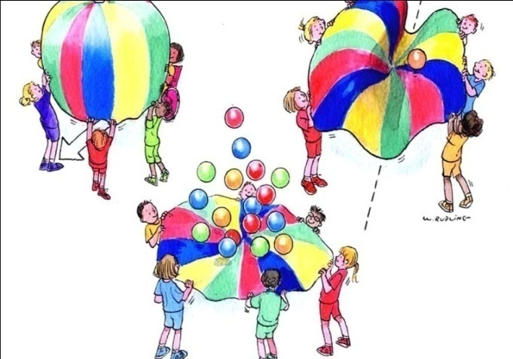
Role play – It is all about enacting a family member, teacher or a friend for venting out of the emotions they develop when in contact with these personality. It helps to know many hidden traits to various unheard stories while a child performs a role play and helps them identify various problem solving and conflict resolution strategies.
Parachute play-It is a play type , involving children holding a parachute in groups which helps them to learn the importance of cooperation , balance , team spirit and assists in the development of fine –motors and eye-hand co-ordination.

Slide 7
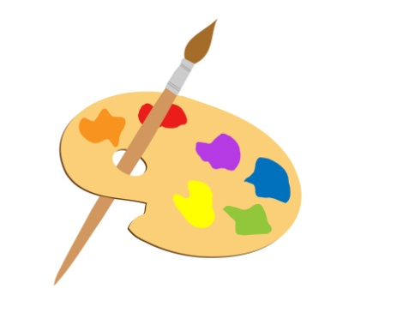
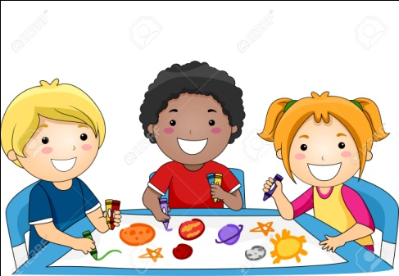
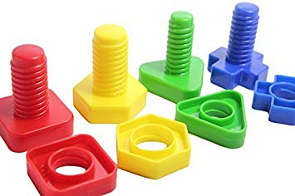
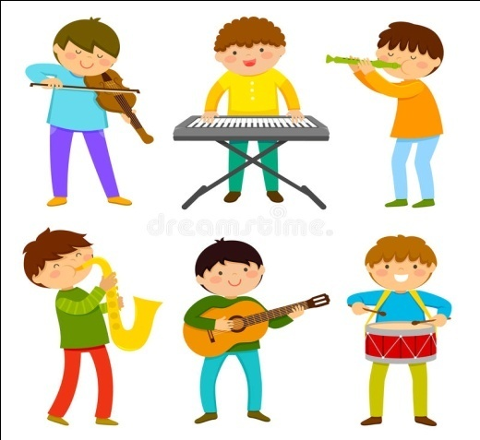
Colourful Play – It is a play wherein a child draws, paints and colours using different art materials. Concept building and skill development takes place.
Musical Play – It involves humming, singing and dancing to different tunes, rhymes and melodies either by listening or playing the music using different musical instruments like guitar, piano, etc. Music and songs not only improve listening and verbal skills but moving around and dancing, also improves balance and flexibility.

Slide 8
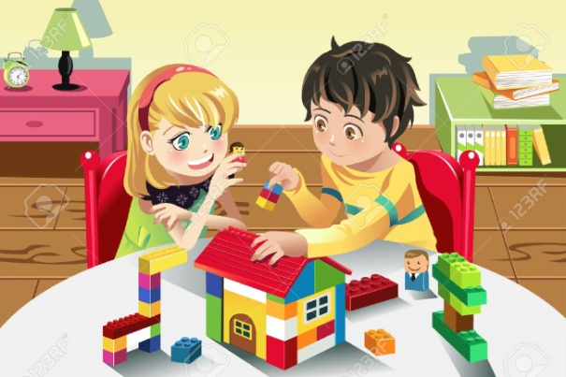
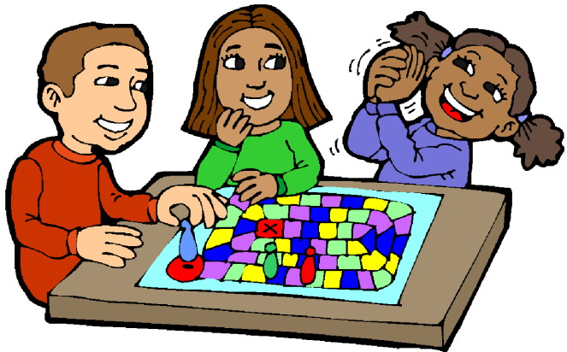
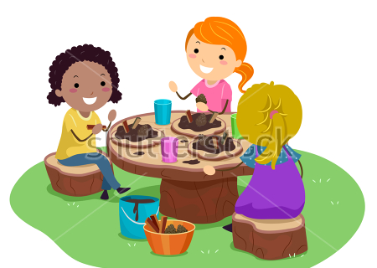
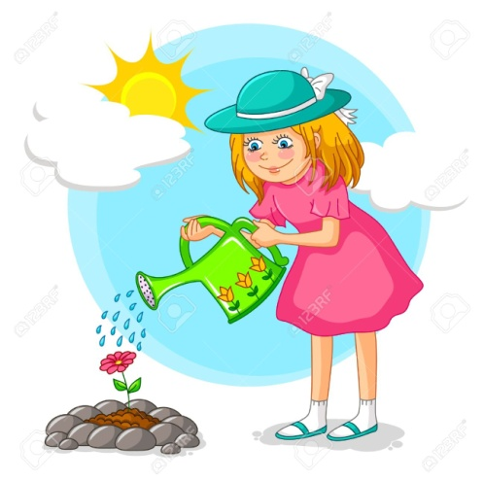
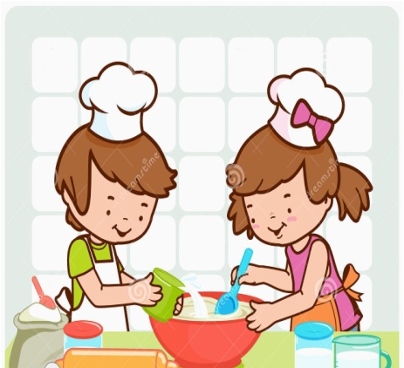
Free play –It involves a set of activities from block building to threading beads to board games , legos, puzzles etc or a combination of above activities.
Apart from this mud play , food play (no flame cooking) , Natural play (Playing in open-natural environment), etc also can be encouraged.
Image Source: www.google.com

Slide 9
So as teachers , parents , counselors and educators – Let’s Encourage play in our teaching and learning strategies , for that the childhood is never going to come again.
Cherish and Capture the moments as these Powerful Plays will play one of the important roles in building your child’s holistic development.
Friedrich Froebel was the first educator to introduce
play as an essential part of the school work.
Play involving activities and experiences that lead to development of balanced emotions and practical skills that can prepare a child to perform his real and routine daily task.
Sense of independence, manipulation, decision making and communication skills, problem solving and conflict resolving, resilience, spatial and logical reasoning, numerical and linguistic development can be promoted through PLAY.

Slide 10
